Slide 1
This slide contains results for modelling performed on the Million Songs Dataset using Pyspark on Hadoop cluster. This is personal work being done and should not be copied.
Modelling techniques used-
Binary and Multiclass
Hyper parameter tuning using Cross Validation
Train Test Split
Sampling techniques used – Upsampling, Downsampling, Stratified sampling
Exploratory Analysis using R and Python
Results for different modelling were combined in Excel to perform comparative analysis.
Not to be copied

Slide 2
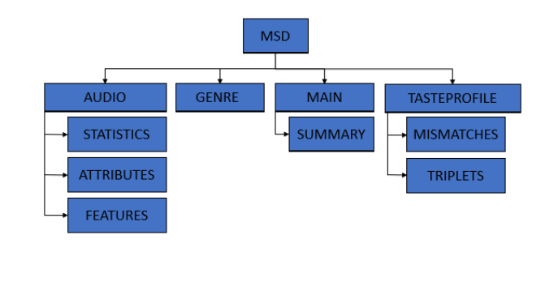
Not to be copied

Slide 3
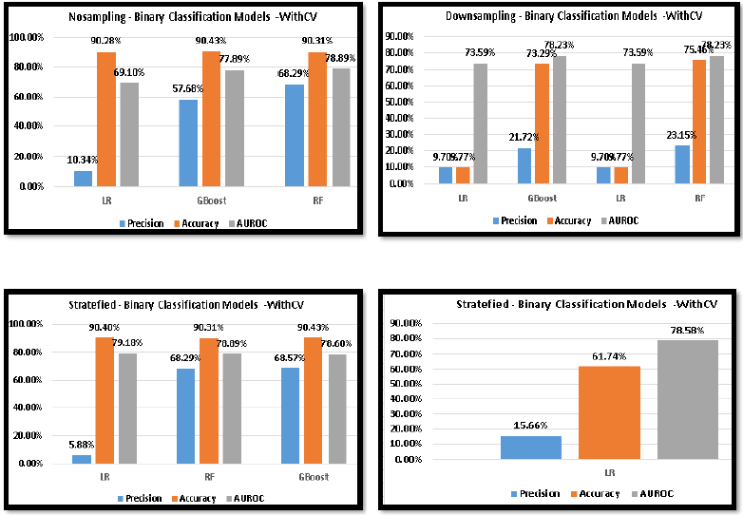
Not to be copied

Slide 4
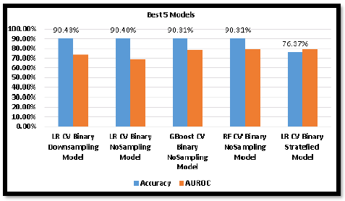
Not to be copied

Slide 5
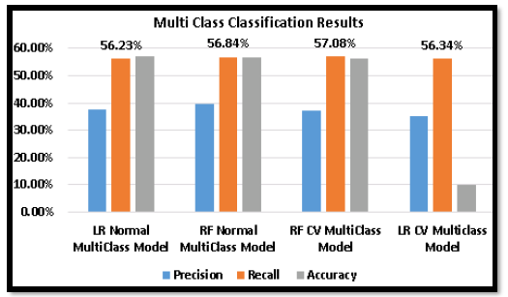
Not to be copied

Slide 6
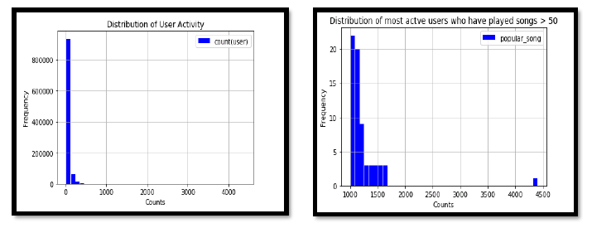
Not to be copied

